Slide 1
Artificial Intelligence

Slide 2
Course Reference Books
“Artificial Intelligence, A Modern Approach” Stuart Russell and Peter Norvig (http://www.amazon.com/Artificial-Intelligence-Modern-Approach-Edition/dp/0136042597)
“Multiagent Systems - A Modern Approach to Distributed Artificial Intelligence”, Gerhard Weiss (http://www.amazon.com/Multiagent-Systems-Distributed-Artificial-Intelligence/dp/0262731312)
“Collective Intelligence in Acton”, Satnam Alag, (http://www.amazon.com/Multiagent-Systems-Distributed-Artificial-Intelligence/dp/0262731312)
“Data Mining Practical Machine Learning Tools and Techniques” Second Edition by Ian. H Witten (http://www.amazon.com/Data-Mining-Practical-Techniques-Management/dp/0120884070)

Slide 3
Throughout the course
Focus on LEARNING
Think about the topics – bigger picture
Not just learning techniques
Need to understand their application
AI is a good topic to ‘read around’
Try to be ‘scientific’ in your approach

Slide 4
Outline
Definition
Intelligence
Artificial Intelligence (AI)
Strong AI vs. Weak AI
AI application
Brief History of AI

Slide 5



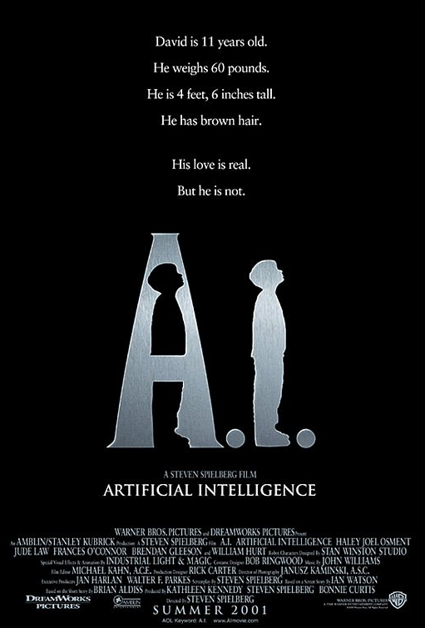
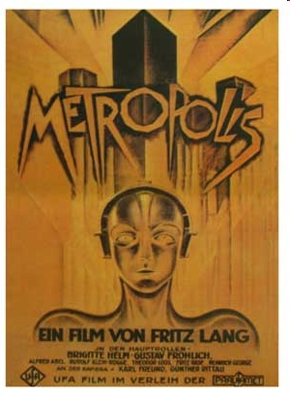
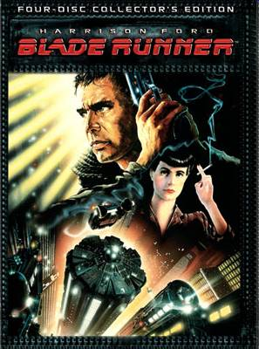
Imagined AI

Slide 6
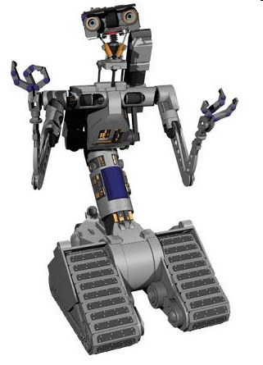
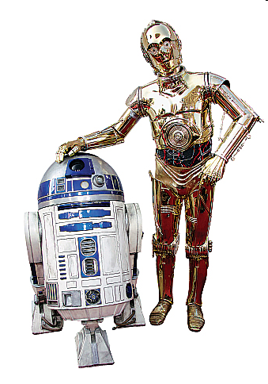
Imagined AI ?

Slide 7
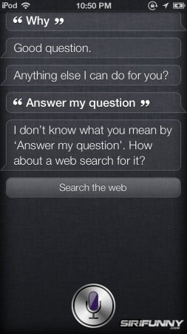
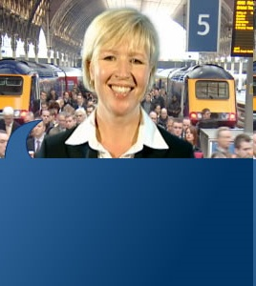
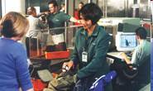
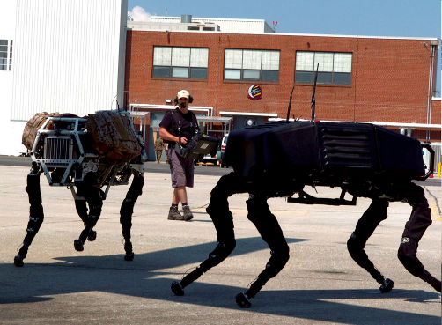
Real AI ?
Need help with our website? Need information about travelling by train?
Just 'Ask Lisa', our new virtual assistant.
Scientists test gait biometrics

Slide 8
What is Intelligence?
How can we define Intelligence?
Is it something tangible?
Do all living species are intelligent?
What about these plants and tress?
“In 1921, the Journal of Educational Psychology asked fourteen leading experts . . . to provide their definitions . . .[they] got 14 different answers back.” (Pfeifer and Scheirer 1999, p. 6)
Let’s define intelligence using some scenarios.

Slide 9
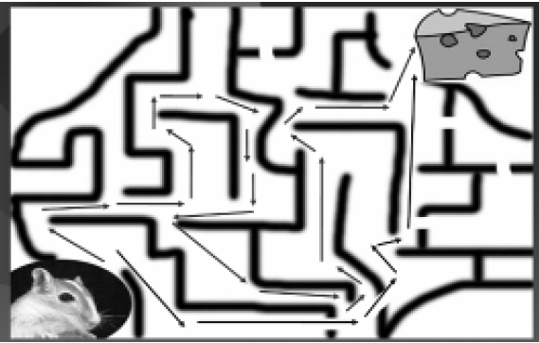
Contd..
The ability to solve a problem. (Problem solving)
a mouse is trying to search a maze in order to find its way from the bottom left to the piece of cheese in the top right corner of the image.

Slide 10
Contd..
Thinking, memory manipulation capability and numerical processing ability is intelligence.
Consider the sequence of numbers
1, 3, 7, 13, 21, ___
What’s the next number?
To answer the question, a little bit intelligence is required.
To solve something, different solutions are thought.

Slide 11
Contd..
The ability to think, plan and schedule is intelligence
In simple cases developing a timetable is simple
Consider we have 100s of students studying in different classes, where we have only a few rooms and limited time to schedule all those classes.
A good planner can manage much better and easily.
So, your coordinators are intelligent.

Slide 12
Contd..
The ability to tackle ambiguous and fuzzy problems
Take an extremely simple and easy question:
Tell us about your height. Are you short, medium or tall?
Different people think differently to the same problem
It becomes more complex when the same person, having observed same measurements solves the same problem in two different ways and reaches different solutions
Notes:
Fuzzy systems and logics

Slide 13
Contd..
Correct and efficient memory and information manipulation based on expertise (Expert Systems)
Suppose you visit a doctor. The doctor takes a few measurements like temperature (T), Blood Pressure (BP), Pulse Rate (PR) etc. Doctor uses these measurements and tries to come up with a diagnosis for the disease based on his previous knowledge.
Previous knowledge is based on some rules. E.g.
“If the patient has a high BP and normal T and normal PR then he is not well”.
“If only the BP is normal then what ever the other measurements may be the person should be healthy” and many such other rules

Slide 14
Contd..
Every human has a distinct pattern of his/her fingerprint. So, can you recognize a person just by looking at his/her fingerprint?
Let us just consider 5 different people and ask a sixth one to have a look at different images of their fingerprints
After having seen the images a several times, he somehow will learn the patterns to make prints distinct.
One may have fewer lines in the print, the other one has sharply curved lines, some might have larger distance between the lines in the print and some might have smaller displacement between the lines and many such features.
..

Slide 15
Contd..
After sometime, that sixth person will be able to look at a new fingerprint of one of those five persons and he might with some degree of accuracy recognize that which one amongst the five does it belong.
The ability to learn and recognize (Machine learning and pattern recognition)

Slide 16
Intelligent Machines
What if?
A machine searches through a mesh and finds a path?
A machine solves problems like the next number in the sequence?
A machine develops plans?
A machine diagnoses and prescribes?
A machine answers ambiguous questions?
A machine recognizes fingerprints?
A machine understands?
A machine perceives?
A machine does MANY MORE SUCH THINGS!
A machine behaves as HUMANS do?
Such a machine will be called Intelligent.
Is this real or natural intelligence?

Slide 17
Formal Definition for AI
“It is the science and engineering of making intelligent machines, especially intelligent computer programs. It is related to the similar task of using computers to understand human intelligence, but AI does not have to confine itself to methods that are biologically observable.”
John McCarthy, 2007.
It’s aim is “to build intelligent entities”.
Russell & Norvig
Notes:
Artificial Intelligence is an effort to create systems that can learn, think, perceive, analyze and act in the same manner as real humans.

Slide 18
Exercise
“A computer can only do what the programmer tells it to do. So a computer cannot be intelligent”.
Is this statement true?

Slide 19
Strong AI vs. Weak AI
Strong AI
Machines act intelligently and they have real conscious minds.
actually tries to recreate the functions of the inside of the brain as opposed to simply emulating behavior
Weak AI
Machines can be made to act as if they are intelligent
treats the brain as a black box and just emulates its functionality
Example:
Take a very intelligent machine and a very trivial specie e.g. a cat.
throw both of them into a pool of water

Slide 20
Some AI application
Robotics
Part mech. Eng. and AI
Reality-- much harder than simulations
Technologies
Vehicles
Rescue
Lots of automation…
Vision (Perception)
Object and character recognition
Scene segmentation
Image classification

Slide 21
Contd..
Logical systems
Theorem provers
Fault diagnosis
Question answering
Games
Deep Blue (IBM supercomputer) vs. Kasparov (world chess champion)
First match, 1996: Kasparov won
Second match, 1997: Deep Blue won

Slide 22
Contd..
Decision Making
Scheduling, e.g. airline routing, military
Route planning, e.g. google maps
Medical diagnosis
Automated help desks
Fraud detection (Expert Systems)
Spam classifiers (a case of NLP)
Web search engines
Movie and book recommendations
… Lots more!

Slide 23
History of AI
Pre-History
The Birth of AI
First program that thought humanly
Development of Lisp
Microworlds
90s…

Slide 24
Pre-History: Tributes of AI
Philosophy
Logic, methods (theories) of reasoning, phil. of mind, learning
Mathematics
Theories of logic, probability, decision-making computation, algorithms
Psychology
Tools and techniques to investigate the human mind and ways to represent the resulting theories
Engineering
Building (fast) computing devices
Linguistics
Theories of structure and meaning of language, Knowledge representation

Slide 25
Contd..
Neuroscience
Information about the network structure of a human brain and all the theories on functionalities of different human organs
Economics
Utility, decision theory
Computer science
Tools and concepts to make AI a reality

Slide 26
The Birth of AI (1956)
The Dartmouth Workshop brings together 10 top minds on automata theory, neural nets and the study of intelligence
Though all the researchers had some excellent ideas, Allen Newell and Herbert Simon dominated the workshop with a reasoning program, the Logic Theorist
Conjecture: “every aspect of learning or any other feature of intelligence can be described so precisely that a machine can be made to simulate it”
Notes:
Conjecture: Notion.. گمان, قیاس آرائی Inference

Slide 27
Contd..
Workshop didn’t lead to any new breakthroughs but an agreement camo out to adopt the new name for the field: Artificial Intelligence
For the next 20 years the field was dominated by these participants, their students and colleagues at MIT, CMU, Stanford and IBM
Notes:
MIT: Massachusetts Institute of Technology
CMU: Carnegie Mellon University
IBM: International Business Machines

Slide 28
First program that thought humanly
Newell and Simon’s early success was followed up with the General Problem Solver (GPS)
Unlike Logic Theorist, this program was developed in the manner that it attacked a problem following the steps that human take when solving a problem
GPS was intended to provide a core set of processes that could be used to solve a variety of different types of problems
Probably the first program that imitated human thinking approach
Notes:
In the early years AI met drastic success. The researchers were highly motivated to try out AI techniques to solve problems that were not yet been solved. Many of them met great successes (GPS,1959)

Slide 29
Development of Lisp
McCarthy (MIT AI lab,1958) defined the high-level language Lisp that became the dominant AI programming language
Limited and expensive computing resources were a serious problem, Invented time sharing
Notes:
Machine language: 1940’s
Assembly language: early 1950’s

Slide 30
Microworlds
Marvin Minsky (1963), a researcher at MIT supervised a number of students who chose limited problems that appeared to require intelligence to solve.
These limited domains became known as Microworlds.
developed programs that solved calculus problems;
developed programs, which were able to accept input statements in a very restricted subset of English language, and generated answers to these statements
E.g. If Ali is 2 years younger than Umar and Umar is 23 years old. How old is Ali?
Answer: Ali is 21 years old.

Slide 31
Contd..
Perceptrons (Minsky and Papert’s book, 1969)
The first successful commercial expert system, R1, (McDermott, 1982)
Neural networks reinvented
Multi-level perceptrons and backpropagation learning
Parallel Distributed Processing (Rumelhart and McClelland, 1986)
90s: Fully recurrent networks and robot control
Ultimately… “neural” networks as data-mining, statistics…

Slide 32
END

